Slide 1
Animal and Plant Care Facility (APCF) Medication Overview
Mia Chan, Pharm. D
NYS Registered Pharmacist
24th November, 2017

Slide 2
Objectives:
Discuss the overview of the medications utilized in APCF
Review and understand the clinical uses of the medications
Promote optimal medication therapy
Improve patient and staff safety
Prevent medication related problems (i.e. adverse effects)

Slide 3
APCF’s animals:
Mouse
Rats
Rabbits
Xenopus

Slide 4
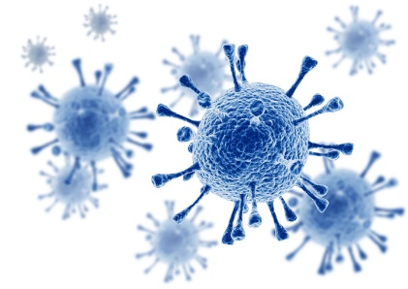
Common Diseases:
Infectious Diseases
Bacterial, viral, fungal, parasitic
Neoplastic Diseases
Tumors, leukemia etc.
Age-related and non-infectious conditions
Malnutrition, hair pulling, thermal shock etc.
Notes:
Diseases: found in laboratory animals
hair pulling (esp. rabbits), thermal shock (xenopus) etc.
Thermal shock, gout, cl, chloamine toxicity in xenopus
Anorexia in rabbits

Slide 5
Medications Category:
Antibiotic
Anesthetic
(Sedatives)
Analgesics/Anti-inflammatory
Corticosteroid
Fluid/ Supplement
Antiparasitic
Anticoagulant
Oxytocin
Antidote
Antineoplastic* Tamoxifen
Notes:
* Not carried in APCF, as per Peter’s request

Slide 6
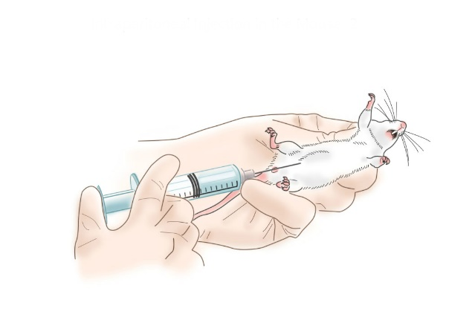
Antineoplastic: Tamoxifen^{1-2,12,13}
Use(s) | Research: to trigger tissue specific gene expression/ knock down specific gene Treat breast cancer in human (Soltamox®)
Dose | Depends on the weight of the subject and purpose of research Intraperitoneal injection
Adverse effects | Associated with an increase incidence of uterine or endometrial cancers Thromboembolic events (life threatening)
Warnings | Human carcinogen, mutagen Pregnant women should not expose/ handle this chemical in any form Always conduct in a certified Class II or III biosafety cabinet Personal Protective Equipment (PPE)
Notes | Minor spills: clean with 10% bleach solution 1 – 2 times, then wash with soap and water Storage: Initial: -70°C (After initial thaw, aliquot and freeze, stable up to 6 months at -20°C) Protect from light
Notes:
Pregnant women should not be exposed to or handle this chemical in any form.
Personal Protective Equipment (PPE)
at a minimum, a lab coat, double Nitrile gloves, and ANSI Z-87 compliant protective eyewear that provides chemical splash protection and appropriate lab attire (full-length pants, closed toe shoes, etc.)
Tamoxifen into smaller research animals should always be conducted in a certified Class II or III biosafety cabinet.
Oral solution: Store at ≤25°C (77°F); do not freeze or refrigerate. Protect from light. Discard opened bottle after 3 months.
Tablets: Store at 20°C to 25°C (68°F to 77°F). Protect from light.

Slide 7
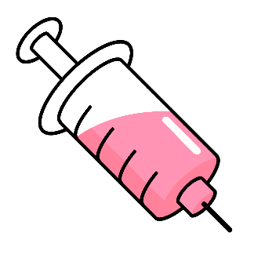
Antibiotic¹⁻⁵:
Use(s) | Bacterial infections
Example(s) | Chloramphenicol – Optomycin® Doxycycline – Vibramycin® Enrofloxacin – Baytril® | Bacitracin, Neomycin, Polymyxin B – Neomycin® (BNP) Dexamethasone, Neomycin, Polymyxin B – Maxisporin® Neomycin, Polymyxin B – Novasporin®
Adverse Effects/ Precautions | Embryo/ fetal toxicity – Doxycycline, enrofloxacin Discoloration of bones and teeth, Photosensitivity – Doxycycline Tendon rupture risk – Enrofloxacin Prolonged use – superinfection (i.e. C. Difficile)
Notes | C. Difficile: Identify by stool test Isolation needed Clean with 10% bleach Alcohol hand rub not effective | ‎✔Human use: Bacitracin, Neomycin, Polymyxin – Neosporin® Chloramphenicol – Diochloram® Dexamethasone, Neomycin, Polymyxin B – Maxitrol® Doxycycline –Vibramycin®
Notes:
Chloramphenicol, Doxy and enrofloxacin - can cross placenta, risk of teratogenic effect
Super infection if used more than 2 months
Alcohol hand rub dose not kill the spores

Slide 8
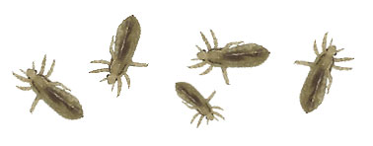
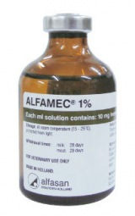
Antiparasitic:¹⁻⁵
Use(s) | Parasitic infections
Example(s) | Ivermectin – Alfamec®
Adverse Effects/ Precautions | Dermatologic conditions : Pruritus, swelling, redness worst case can cause Mazzotti reaction (life threatening)
Notes | No treatment for Mazzotti reaction, only supportive care‎ | ✔Human use: Invermectin – Stromectol®
Notes:
Lice and mites common found in rats
Even eye drop can cause Mazzotti reaction
If happened supportive care (eg, hydration and/or parenteral corticosteroids) to treat postural hypotension. Antihistamines and/or aspirin have been used for most mild to moderate reactions.

Slide 9
Anesthetic (Sedative) ^{1-5,7}:
Use(s) | Sedative, induce sleep (for procedure)
Example(s) | Acepromazine (ACP) – PromAce®, Aceproject® Ketamine – Ketacine®/ Ketaset®/Ketaflo®/Vetalar® Medetomidine – Dorbene® Phenobarbital – Dorminal® Proparacaine – Primax® Isoflurane – Isoflo® | Offered by AlfaMedic: Diazepam – Pamlin® Midazolam – Dormicum®
 | Xylazine – Rompun®, Anased®, Sedazine®, Chanazine®
Adverse Effects/ Precautions | Brain development – ketamine (prolonged use) Seizures (worse case: epilepsy) Respiratory depression (except: Proparacaine) Embryo/ fetal toxicity – Acepromazine, ketamine, medetomidine, phenobarbital , diazepam, midazolam
Notes | Phenobarbital – Euthanasia (high-dose) High mortality rates – ketamine, phenobarbital (neonatal rodents) | ✔Human use: Chlorpromazine – n/a Dexmedetomidine – Precedex® Diazepam – Valium® Ketamine – Ketlar® Midazolam – Versed® Isoflurane – Forane®, Terrell®
Controlled substance in US
Notes:
xylazine can be use as sedatives and also analgesics (does dependent)
Ace in human before to use as antipsychotic – chlorpromazine
Chlorpromazine – box warning: cannot use in dementia related psychosis will incr,. Risk of death
Ketamin – street drug/ highly abusive aka Jet/ KitKat/ k jai
Ketamine produces dose dependent increases in uterine contractions; effects may vary by trimester
Medetomidine – dose dependent, more potent than xylazine (?) sleep very long K+M+B(T), may need antidote

Slide 10
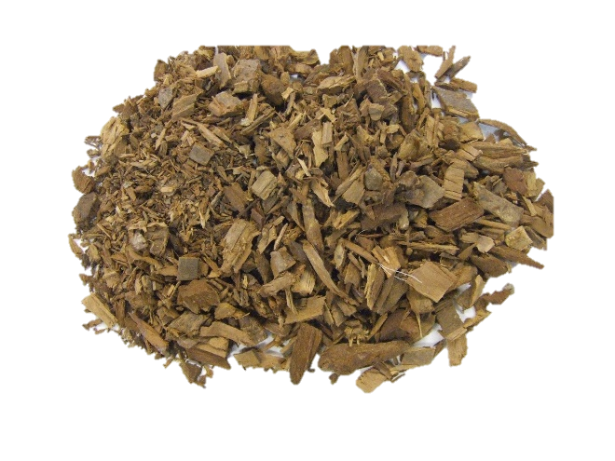
Antidote¹⁻⁶:
Use(s): as reversal agents, to counter act the effect of anesthetics
Medication | Antidotes
Acepromazine | Norepinephrine
Ketamine | None, supportive care only
Medetomidine | Atipamizole/ Yohimbine
Phenobarbital | Cholestyramine/ Pentylenetetrazol
Xylazine | Atipamizole/ Tolazoline/ Yohimbine
Diazepam | Aminophylline/ Flumazenil
Midazolam | Aminophylline
Fentanyl | Butorphanol/ Nalbuphine
Yohimbine
Atipamezole – Alzane® (preferred; animals only)
Notes:
Atipamezole – Alzane® (preferred; animals only)
Yohimbine - primarily in the treatment of sexual dysfunction, weight loss, and dry mouth.
Xylazine- Human accident report; sugg. Yohimibe maybe effective antidote toxicity in man¹⁰

Slide 11
Analgesic/ Anti-inflammatory^{1-5,7-11} :
Use(s) | reduce pain and fever, decrease inflammation (high dose)
Example(s) | Buprenorphine – Temgesic® Butorphanol - Utomidor® Lidocaine – Xylocaine® Tramadol – Ultram®, Tramal® | Fentanyl/ fluanisone - Hypnorm®
 | Xylazine – Rompun®, Anased®, Sedazine®, Chanazine®
Adverse Effects/ Precautions | Pica – Buprenorphine (esp. in rats) Respiratory depression – Buprenorphine, Fentanyl Embryo/ fetal toxicity
Notes | Opioids: Buprenorphine, butorphanol, fentanyl, tramadol Opioid toxicity: Decreases consciousness Pinpoint pupil Respiratory depression Antidote: Naloxone |  | ✔Human use: Buprenorphine – Belbuca ® Butorphanol – Stadol® Fentanyl – Duragesic® Lidocaine - Xylocaine® Tramadol – Ultram®
Controlled substance in US
Notes:
Fentanyl/ fluanisone - Hypnorm® - typical antipsychotic and sedative
Butophanol has sedatives and also analgesics (does dependent)
Lidocaine actually only reg for huaman?
Naloxone – reverse resp. depression d/t od opiod

Slide 12
Analgesic/ Anti-inflammatory ^{1-5,7} :
Use(s) | reduce pain and fever, decrease inflammation (high dose)
Example(s) | Carprofen – Rimadyl ® Flunixin – Finadyne ® Meloxicam – Metacam®
 | Chlorpheniramine, Riboflavin, Pyridoxine, Biotin, Niacinamide, Methionine – Melermins®
Adverse Effects/ Precautions | GI distress (esp. use with corticosteroids) – ulcerations, GI bleed
Notes | Alternative or as supplement to opioids (safer) Avoid concurrent use with corticosteroids | ✔Human use: Meloxicam – Mobic®
All NSAIDs
Notes:
NSAID : Non steroidal inflammatory drugs
濕疹、皮膚炎、口角糜爛、口內炎、過敏性氣喘、過敏性鼻炎、皮膚搔癢症 - melermins

Slide 13
Corticosteroid:
Use(s) | Decrease inflammation (less swellings and redness)
Example(s) | Dexamethasone – Azium SP®, Dexasone®, Decadron® |  | Other examples: Prednisone – Dexasone® Prednisolone – Prelone®
Adverse Effects/ Precautions | GI distress (esp. use with NSAIDs) Weight gain (long term use) Crosses placenta – birth defect (i.e. oral cleft), decreased birth weight
Notes | Faster acting than prednisone and prednisolone | ✔Human use: Dexamethasone – Zodex® Prednisone – Deltasone® Prednisolone – Prelone®
Notes:
Reduce inflammation (less swellings and redness)
1st trimester
Pred not carry in this facility

Slide 14
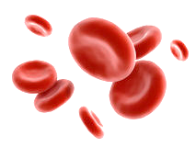
Anticoagulant:¹⁻⁵
Use(s) | Prevent blood clot, blood vessel cannulation, Hematology (study of blood)
Example(s) | Heparin – n/a
Adverse Effects/ Precautions | Bleeding risk May interfere the morphology of the sample Heparin induced thrombocytopenia (HIT) – very rare Sharp decrease in platelet count
Notes | ✔Human use: Heparin – n/a Often use in bed bound patients, to prevent DVT and PE Preferred over other heparin derivatives in renal impairment patients (no dosage adjustment needed)
Notes:
Blood vessel cannulation – repeat samples needed

Slide 15
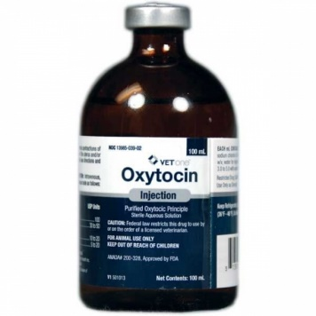
Oxytocin^{1-3,5,7}:
Use(s) | Stimulate uterine contractions to induce labor Responsible for milk secretion during lactation
Dose | Rat: 0.2-3 units/kg SC Rabbit: 1 – 2 unit IM or SC
Adverse Effects/ Precautions | CNS effects (i.e. seizures) Uterus rupture or postpartum bleeding Relatively safe at reasonable dosage
Notes | ✔Human use: Oxytocin – Syntocinon®, Pitocin®

Slide 16
Fluid/ Supplement¹⁻⁵:
Use(s) | Provides essential nutrients
Example(s) | Vitamin B complex, Vitamin C 5% Dextrose injection, Lactated Ringer’s injection
Adverse Effects/ Precautions | Megadoses (Large dose) of : Vitamin B₃ (niacin): nausea, jaundice, diarrhea Vitamin B₆ (pyridoxine): nerve toxicity Vitamin B₉ (Folate): mask B12 deficiency Vitamin C: diarrhea, nausea
Notes | Minerals/ vitamins imbalance has a greater impact on rabbit: Hypercalcemia: too much will cause extensive calcification of soft tissue Vitamin A: deficiency and toxicity have been associated with reproductive problems Vitamin E: deficiency shows muscular dystrophy, abortion, stillbirth and neonatal deaths
Notes:
NS is more hypertonic compare to lactated ringer- can cause metabolic acidosis in large volum
Lac metabolic alkalosis -
NS only has NaCl but Lac has other electrolytes
Lactated is closest to blood crystalloids
Warm the soln → maintain animal temp.: sq,ip or iv
B6 pyridoxine
Rabbit excret cacium thru urinary excretion while most mamales excrete via bile
Vit d plays role in calcium absoption
A: abortion, hydrocephlleus
E: amt need unknown

Slide 17
Conclusion:
Explore and enhance knowledge of medications (clinical use, example and adverse effect of medications etc.)
Improve animals (patients) outcome and quality of life

Slide 18
Reference:
Micromedex® 2.0, (electronic version). Truven Health Analytics, Greenwood Village, Colorado, USA. Available at: http://0-www.micromedexsolutions.com.liucat.lib.liu.edu/. November 22, 2017.
Lexicomp Online®, Lexi-Drugs® , Hudson, Ohio: Lexi-Comp, Inc.; November 22, 2017.
Sharp P, LaRegina MC. The laboratory rat. Boca Raton, FL: CRC Press LLC; 1998
Suckow MA, Danneman P, Brayton C. The laboratory mouse. Boca Raton, FL: CRC Press LLC; 2001
Suckow MA, Douglas FA. The laboratory rabbit. Boca Raton, FL: CRC Press LLC; 1997
American Board of Veterinary Toxicology. Available at: https://www.abvt.org. November 23, 2017.
Carpenter, J., Mashima, T., & Rupiper, D. (2001). Exotic Animal Formulary (2nd Edition). St. Louis: Saunders.
Ducommun, D. (2000). Rat Health Care, 6th Edition. Rat Fan Club.
ACOG Committee on Obstetric Practice. ACOG Committee Opinion No. 474: nonobstetric surgery during pregnancy. Obstet Gynecol. 2011;117(2 Pt 1):420-421.
Samantha A, Roffe C, Woods KL. Accidental self administration of xylazine in a veterinary nurse. Postgrad Med J. 1990 Mar; 66(773): 244–245.
Mackintosh, C. Potential antidote for Rompun (xylazine) in humans. NZ Med J 1985, 98: 714-715.
Merk. http://www.merckmillipore.com/HK/en/product/InSolution-Tamoxifen-4-Hydroxy-Z-CAS-68047-06-3-Calbiochem,EMD_BIO-508225. November 23, 2017.

Slide 19
Thank you for your time!

